Slide 1
FVS Customer Portal
Valves, service, and support…delivered

Slide 2


Valves, service, and support…delivered
*** IMPORTANT NOTICE ***
The customer portal is intended for quoting purposes only.

Slide 3
Table of Contents
–FVS Customer Portal Overview
–Account Setup & Maintenance
–Search for Parts
–Request for Quote
–Reviewing Order/Quote History
–Reviewing Documents

Slide 4
Customer Portal Overview
What is FVS Customer Portal?
FVS Customer Portal is Forum Energy Technologies – Valve Solutions new web portal. The new portal has a similar look and feel to our previous customer portal but will provide enhanced functionality. We hope that this tool provides you a more robust and satisfactory customer experience.
What can I do with FVS Customer Portal?
With the FVS Customer Portal, you will be able to view our product catalogs, product availability and pricing. You will have real-time access to available quantities and pricing. You will also have the ability to view your quote, order and shipment history as well as retrieve shipping documents for each.
How do I signup?
Please request for registration on the new portal via this link____. Please note there are two options.
You can register as an administrator for your business, that will allow you to manager your sales team or you can register each individual salesperson as a standard buyer.

Slide 5
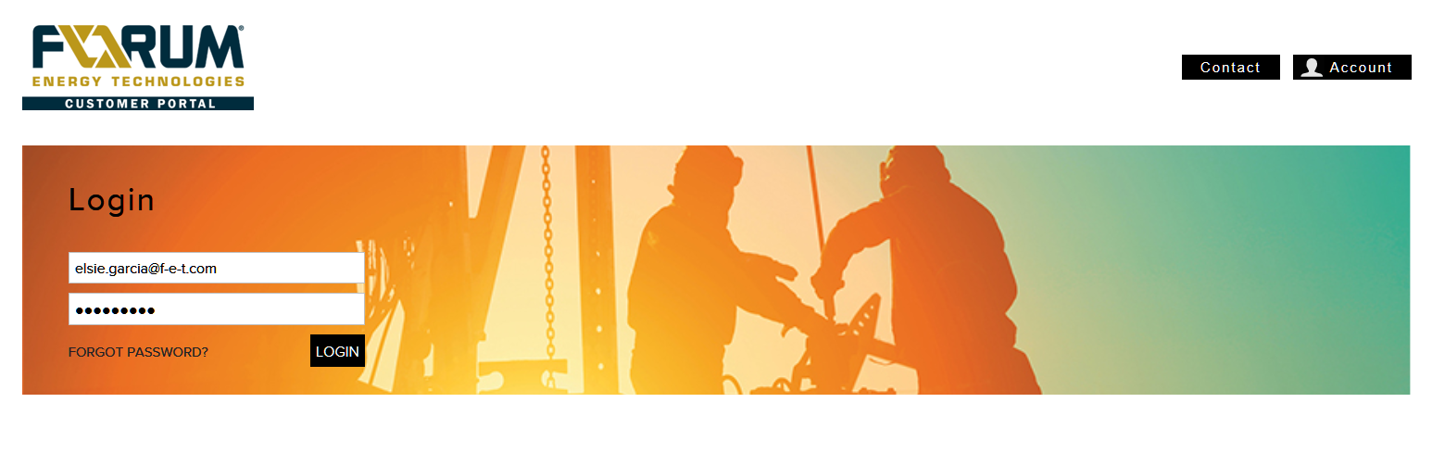
Account Setup & Maintenance
Once you receive an automated email from FVS Web Store notifying you an account has been setup, follow the hyperlink. You can always access FVS Webstore at:
http://https://customerportal.f-e-t.com/
Note that you must use the Internet Explorer web browser (version 7.0 or higher) to access Customer Connect. It is not compatible with the Mozilla Firefox or Apple Safari browsers.
Type in your email address and temporary password provided in the email.

Slide 6
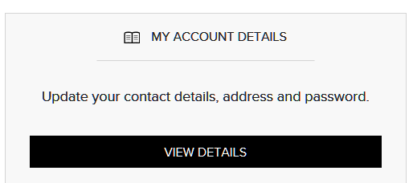
Account Setup & Maintenance Cont…
You can change your password and password hint by going to “MY ACCOUNT DETAILS” section.
Click on VIEW DETAILS, a window will pop up with user information.
- ACCOUNT DETAILS = User First and Last Name, Customer Number, Contact Number, Company Registration No (if applicable), Company VAT No(ifapplicable).
- BILLING ADDRESS DETAILS
- LOGIN DETAILS

Slide 7
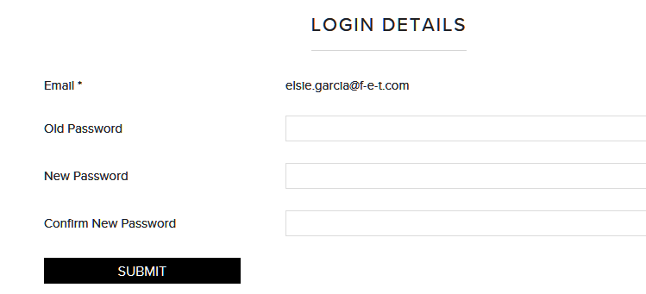
Account Setup & Maintenance Cont…
To Change Password:
Enter your old password. Tab to New Password and enter your New Password. Tab to Confirm New Password and re-enter the new password.
Click “Submit” when done.

Slide 8
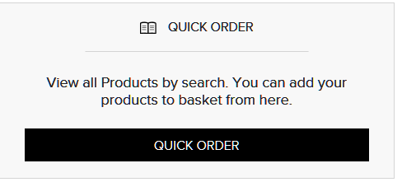
Search for Parts
To Search for Parts, select “QUICK ORDER”
FVS Customer Portal has robust search functionality.

Slide 9
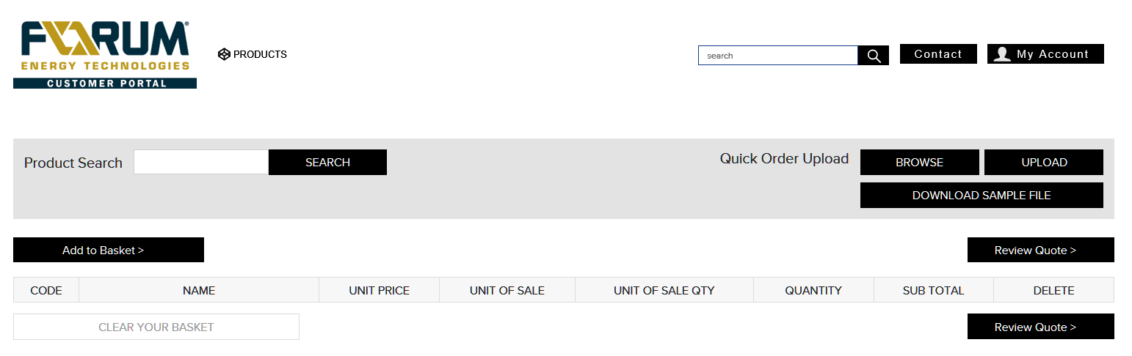
Search for Parts Cont…
Clicking QUICK ORDER will take you into the search screen.
You can search based on description, figure number, ANSI Class / PSI and size.
Note: The more information provided gives more specific results, which will also decrease the return time for search.
Using the Search field in the top right corner enter search information.

Slide 10
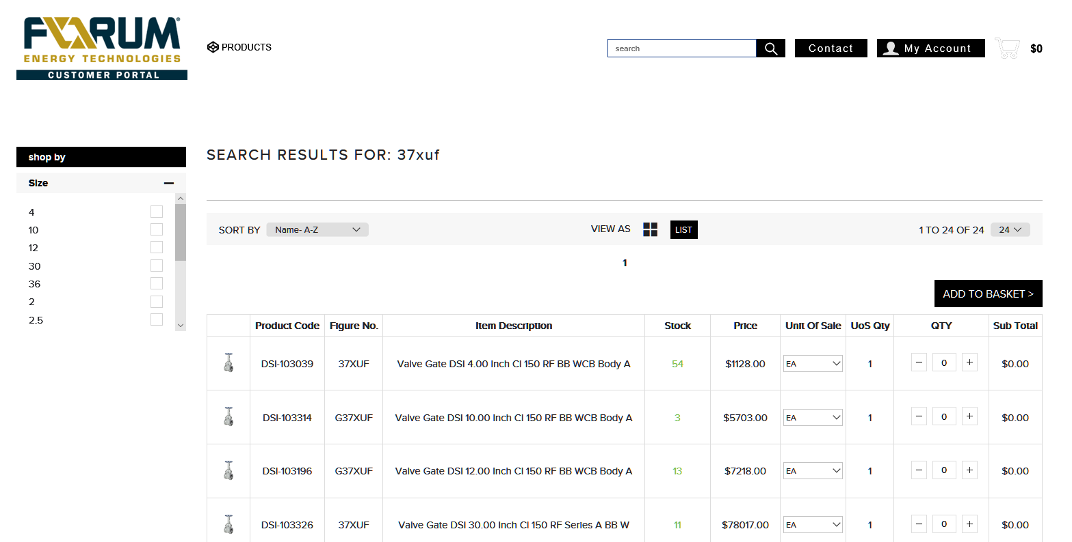
Search for Parts Cont…
General search brings up general information.
• As you see results for your search, please note you will see a line per figure number.
• Then you will be able to select various sizes, using the drop down menu under size.

Slide 11
Search for Parts Cont…
When item number/product code available use the product Search field.
Using the item number in the Product Search field will only list that particular item description.

Slide 12
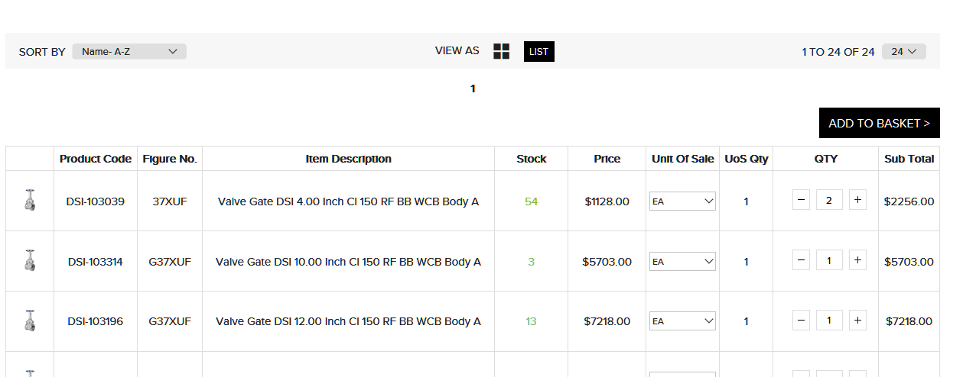
Request for Quote
Once you have found the part you would like to order, enter the quantity in the Quantity Box and then click “ADD TO BASKET.”

Slide 13
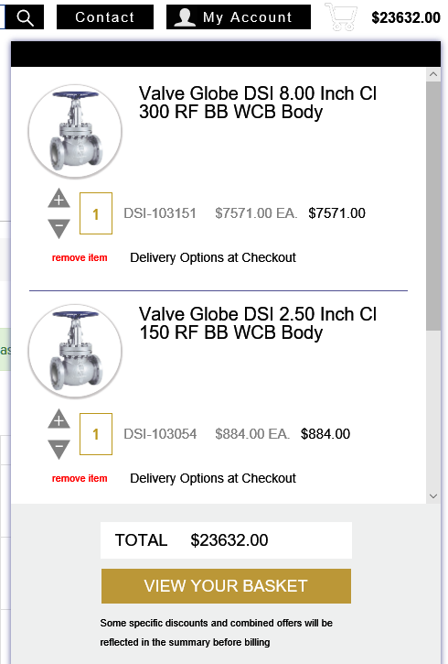
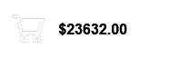
Request for Quote Cont…
• As you are adding parts to your cart, they are being saved into a cart that will be ready for you to proceed to purchase when finished. To view your cart at any time, Click on the Shopping Cart icon in the top right corner, next to the $ value in the cart. Then click on “View Your Basket” from the drop down.

Slide 14
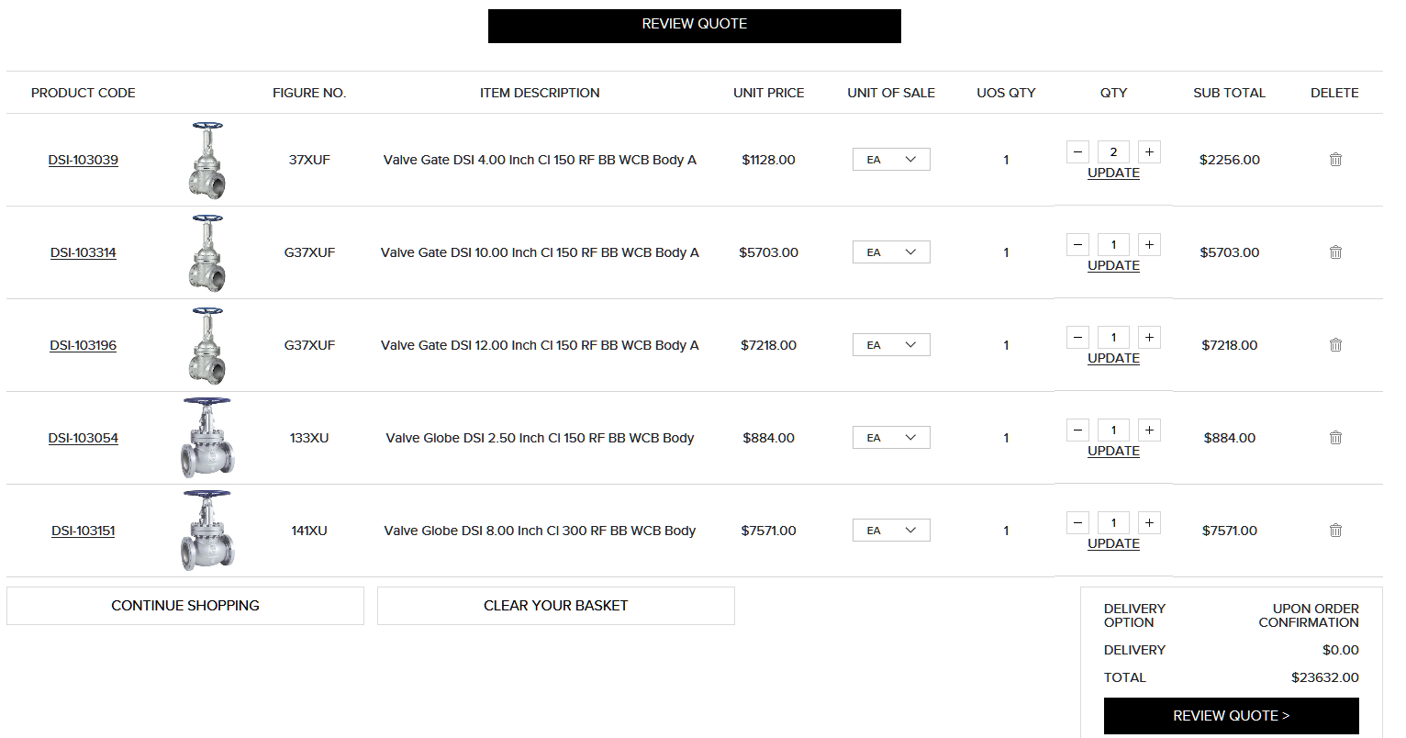
Request for Quote Cont…
• You can continue to search for parts and add them to your cart by selecting “CONTINUE SHOPPING”. You can also increase/decrease quantities of each part by clicking the “-/+” button for each item.
• You can remove the entire item by clicking on the “Trash Can” icon.
You can remove the entire item by clicking on the “Trash Can” icon.
Last 2 internal audits and no. of findings:

Slide 15
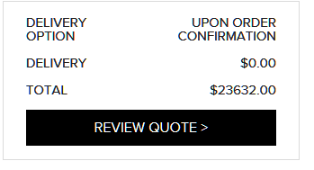
Request for Quote Cont…
When all items and quantities are correct in the cart, click on Review Quote

Slide 16
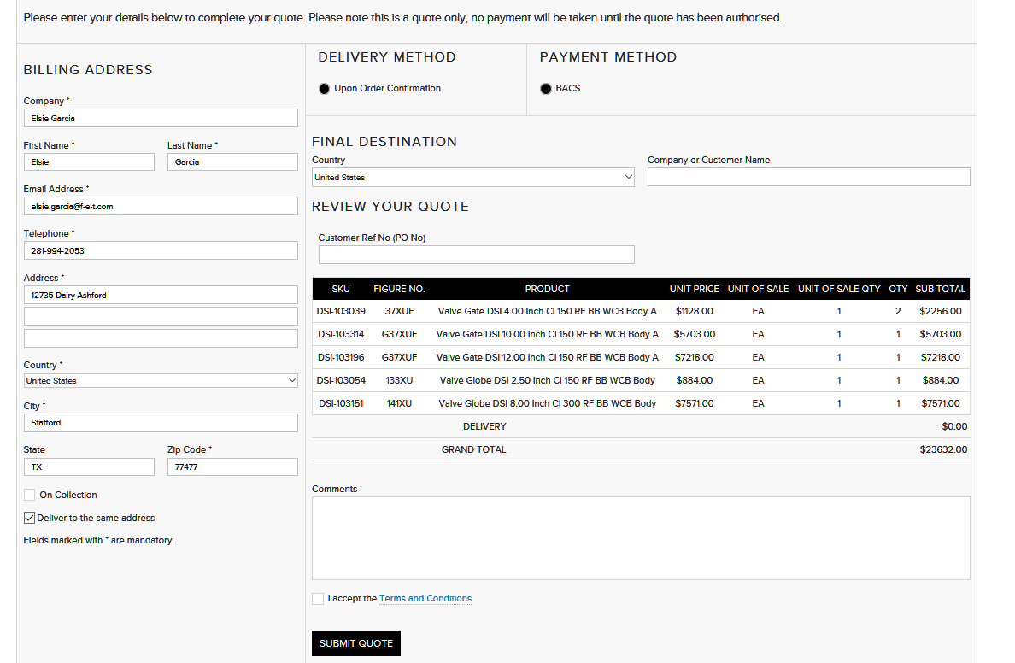
Request for Quote Cont…
The quote screen will pop up. Review information listed.
Review Information listed

Slide 17
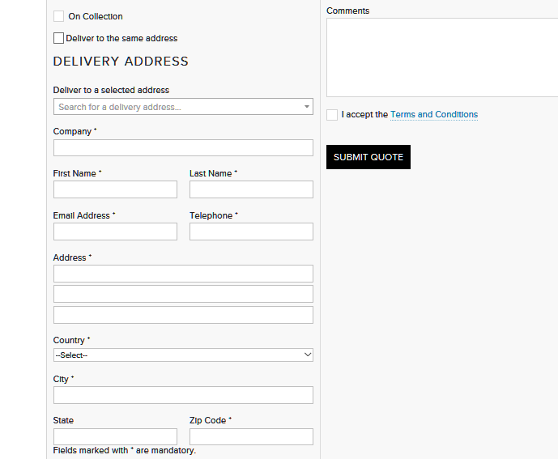
Request for Quote Cont…
If delivering to a different address than the Billing Address, uncheck the Deliver to the Same Address field and Deliver Address fields will populate.

Slide 18
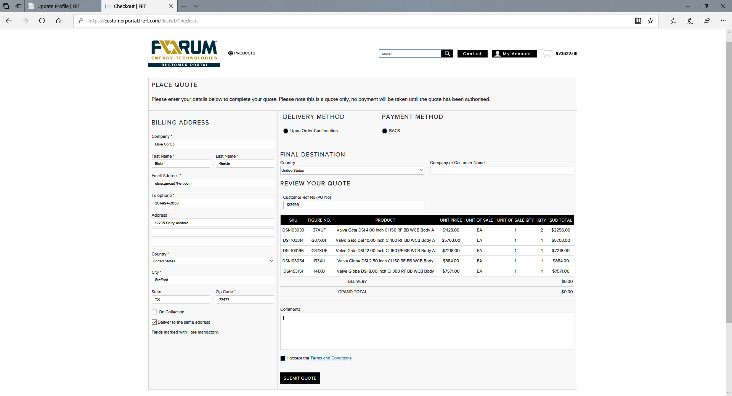
Request for Quote Cont…
• You will be required to fill in the final destination and Company Name fields in order to proceed “Submit Quote.”

Slide 19

Request for Quote Cont…
*** PLEASE NOTE AT THIS POINT YOU HAVE SUBMITTED A QUOTE REQUEST ONLY, UNLESS NOTATED IN THE COMMENTS SECTION TO PROCEED AS ORDER. ***

Slide 20
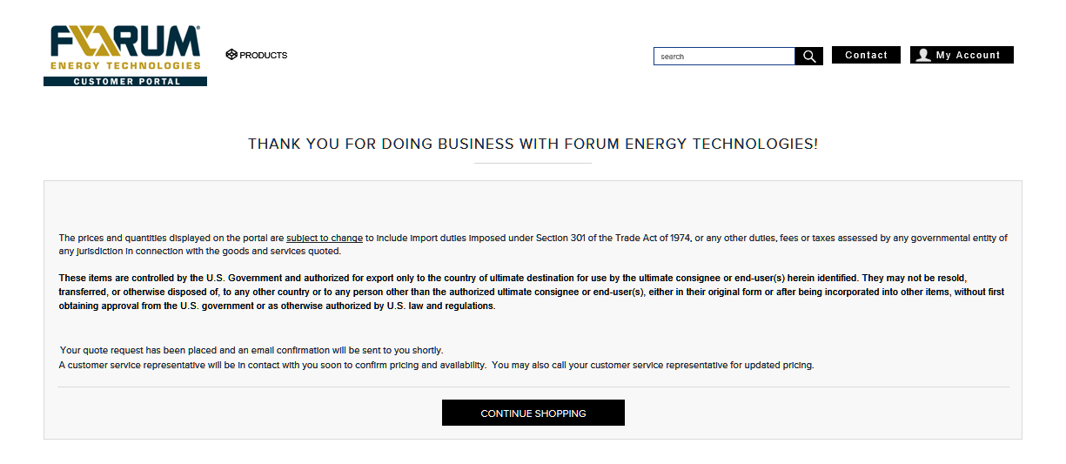
Request for Quote Cont…
• If a Quote is not required and an order is to be placed directly from information listed note in the Comments section and include PO information in Customer Ref No (PO No) section.
• Terms and Conditions must be accepted in order to proceed.
• A customer sales representative will be contacting you with our offer.

Slide 21
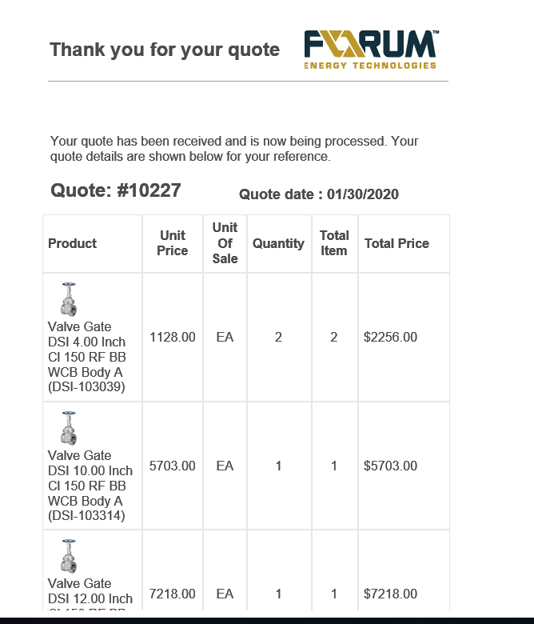
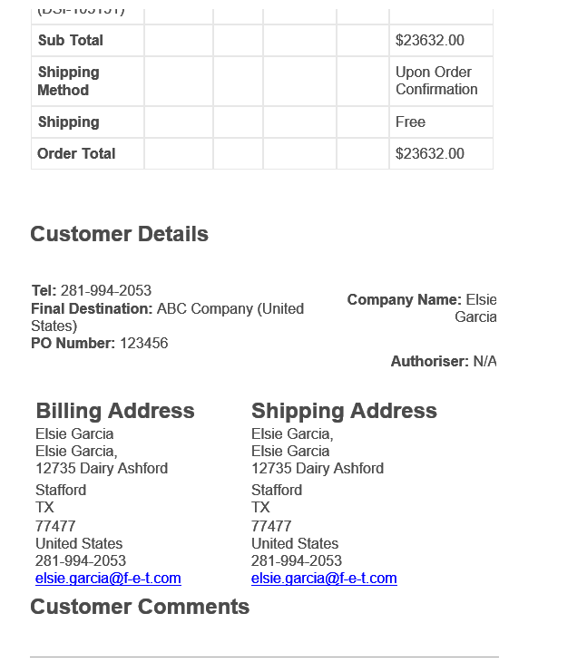
Quote Confirmation
A confirmation email will be sent to the email provided for the account. The email will contain your quote # and date quote provided.
You can reference this quote number with your customer sales representative.

Slide 22
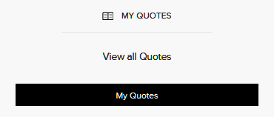
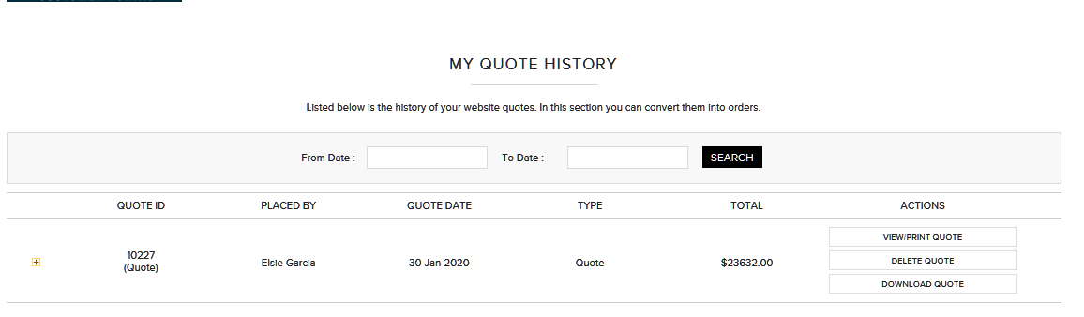
Reviewing Quote/Order History
Using FVS Customer Portal you will be able to review and track prior transactions.
MY QUOTES – will show you history on previous quote request by date.
** Any quote that becomes an order will not show in MY QUOTES, it will be tracked thru MY ORDER HISTORY

Slide 23
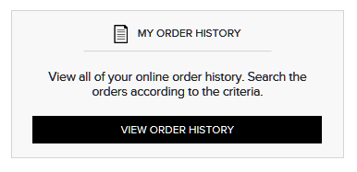
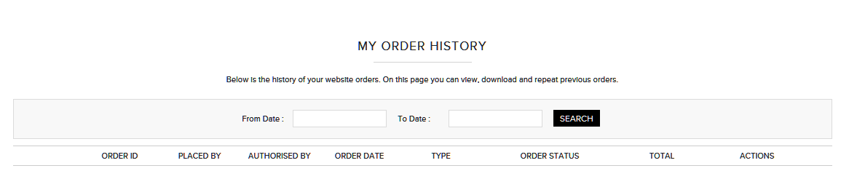
Reviewing Quote/Order History Cont…
MY ORDER HISTORY – will show you history on previous ORDERS by date.

Slide 24
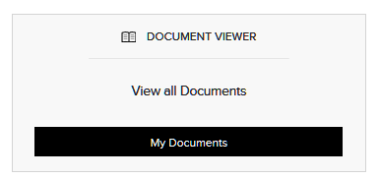
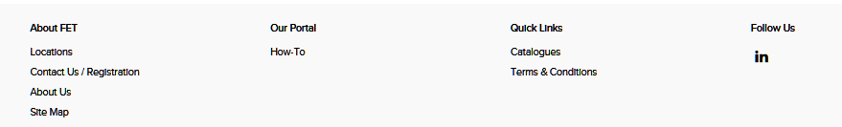
Document Viewer
Document Viewer will display documentation available for your order.
All documents related to your order including invoice, certificates and shipping documents will be available in your customer dashboard.

